Slide 1
Topic 5: Architecture Description Language (ADL)

Slide 2
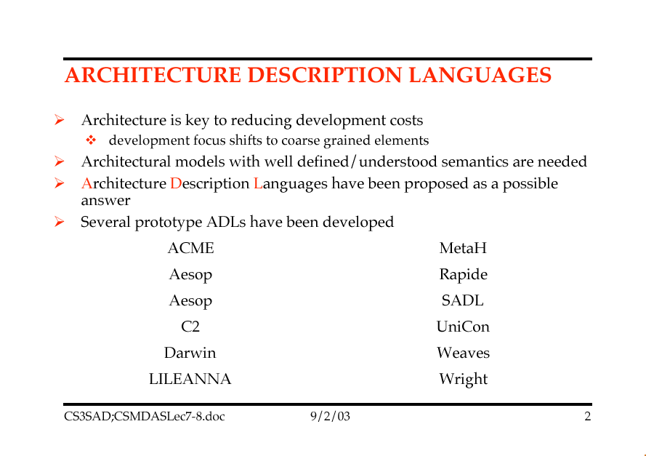

Slide 3
Architecture Definition Languages
An architecture is generally considered to consist of components and the connectors (interactions) between them however we are inconsistent and informal in their use and therefore
Architectural designs are often poorly understood and not amenable to formal analysis or simulation.
(Remember.. How can I evaluate on Architecture over another?)
Architectural design decisions are based more on default than on solid engineering principles.
Architectural constraints assumed in the initial design are not enforced as the system evolves.
Unfortunately there are few tools to help the architectural designers with their tasks.
To address these problems, formal languages for representing and reasoning about software architecture have been developed.
These languages, called architecture description languages (ADLs), seek to increase the understandability and reusability of architectural designs, and enable greater degrees of analysis.
In contrast to Module Interconnection Languages (MILS), which only describe the structure of an implemented system, ADLs are used to define and model (the) system architecture prior to system implementation.

Slide 4
ADL Requirements
Our Original Dilemma
When to pick our architecture over another ?
Characteristics of Architectural Descriptions
Common Patterns of Software Organization
What do all these boxes and interconnecting lines really mean?
Data flow ? Data dependencies?, Control ? , Functional dependencies ? Functional Sequences ?. States & Modes ?
therefore we really do need a more precise way in which to capture and describe an architecture
Examples of Common Components and Interconnections:
Examples of Interactions between these components
Critical Elements of a Design Language
The Language Problem for Software Architecture

Slide 5
ADL Requirements
Examples of Common Components and Interconnections
Computation, Memory, Server, Controller, Link (Interfaces), (list others)
Examples of Interactions between these components
Procedure Call, Data Flow, Message Passing, Shared Data, .. (list Others)
Note that components and interactions are evident across all the architecture styles and their variants.
The good thing .. A common set of primitives (Abstract concepts in an earlier lecture).
Critical Elements of a Design Language
The Language Problem for Software Architecture

Slide 6
ADL Requirements
Critical Elements of a Design Language
Components: Primitive elements and their values
(give examples)
Operators: Functions that combine Components
(give examples)
Abstraction: Naming rules for components and operators
(give examples)
Closure: Rules that determine which abstractions can be added to the classes of components and operators
(give examples)
Specification: Association of semantics with syntactic forms.
(give examples)

Slide 7
ADL Requirements
The Language Problem for Software Architecture
Note: SWA deals with the overall allocation of functions to components, with data and interface connectivity and overall system balance (task allocation, file allocation, dead-lock recovery, fault-tolerance, etc….)
Do conventional programming languages support this ?
Does UML support this ?
Does “Z” support this ?
So where do we go from here ?
So we need a way to allow us to combine the components, operations, interfaces etc into an ARCHITECTURE.
So then why not just use Ada, and CORBA, … etc.?
So where do programming languages fit in the scheme of things ?

Slide 8
ADL Requirements
An ADL therefore must:
Support the description of components and their interactions
Why ?
Handle large-scale, high-level designs
Why?
Support Translation of Design to a Realization
Why ?
Support user-defined or application Specific Abstractions
Why?
Support the Disciplined selection of architectural styles.
Why ?

Slide 9
ADL Requirements
Composition:
“It should be possible to describe a system as a composition of independent components and connections”
This allows us to combine independent elements into larger systems (this is really critical in Network centric independent systems that demonstrate new emergent capabilities when combined together)
An ADL therefore:
Must allow the hierarchical decomposition of and assembly of a system.
Final Decomposed elements must be independent (stand-alone) pieces in their own right.
Must be able to separate architectural design approach from realization approach.
Note: the ADL closure rule must allow us to view entities of an architectural description as primitive at one level and as composite structures at a lower level of decomposition.
Why is this important ?

Slide 10
ADL Requirements
Abstraction:
“It should be possible to describe the components and their interactions within the software architecture in a way that clearly and explicitly describes their abstract roles in a system”
This property will allow us to describe explicitly the kind of architectural elements used and the relationships between the elements
Note the contrast with high level programming languages vs ADL.
For example:
It should be possible to describe an architecture without having to relay on implicit coding conventions or unstated assumptions about the intended realization.
(Remember how benign ACME looks)
Note: It should be able to indicate explicitly that components are related via a Client-Server relationship (regardless of how they might be implemented) NOT implicitly by looking at lower level IDL or procedure calls.
For example I could implement a C-S relationship in “C”. But you would not know that we have C-S relationship unless you went digging through the low level code.)
We want to get away from the code and IDL level. (those are implementation realization, not abstract roles. Ie. We want to be at the Client module and a Server Module level.
Service based Architecture ?

Slide 11
ADL Requirements
Reusability:
“It should be possible to reuse components, connectors, and architectural patterns in different architectural descriptions, even if they were developed outside the context of the system”
This property will allow us to describe families of architectures as an open-ended collection of architectural elements, together with constraints on the structure and semantics.
These Architectural patterns require further instantiation of substructure and indefinite replication of relations.
See the GOF book.
Note that programming languages permit reuse of individual components, FEW make it possible to describe generic patterns of components and connectors.
Programming languages provide module constructs only (Ada) few allow us to talk about collections of modules or structural patterns.
For example a pipeline architecture uses pipes & filters AND also constrains the topology to be a linear sequence (but we cannot describe the topology).

Slide 12
ADL Requirements
Configuration:
“Architectural Descriptions should localize the description of system structure independently of the elements being structured. They should also support dynamic reconfiguration.”
This property allows us to understand and change the architectural structure of a system without having to examine each of the systems individual components.
Therefore an ADL should separate the description of composite structures from the elements in these compositions so that we can reason about the composition as a whole.
See the comment on dynamic architectures in your text.

Slide 13
ADL Requirements
Heterogeneity:
“It should be possible to combine multiple, heterogeneous architectural descriptions”
This property will allow us to:
Combine single combined different architectural patterns into a single system.
Combine components written in different languages
(marshaling).
Module connection systems that support interaction between distinct address spaces often provide this capability (see book examples)

Slide 14
ADL Requirements
Analysis:
“It should be possible to perform rich and varied analyses of architectural descriptions”
Note that current module connection languages (Ada) provide only weak support for analysis. (only type checking at component boundaries)
Note how JINI has started to address the issue of event broadcast.
Need to associate an specification with an architecture as they become relevant to a particular components, connections, and patterns.

Slide 15
Problems with Existing Languages
Informal Diagrams
Programming Language Modularization Facilities
Module Interconnect Languages
Support for Alternative Kinds of Interaction
Specialized Notation for Certain Architectural Styles

Slide 16
Informal Diagrams
Informal diagrams are used to express many ideas:
the boxes can represent anything from components to functions,
the interconnections are equally vague at identifying the interaction they were meant to convey.
Data flow? , Control Flow? , Event Handling? Inheritance ? , etc.
Note that although they intuitively convey the architecture, they are limited in the use for analysis
WS (1)
WS (…)
WS (n)
UI
UI
UI
Functions..
Functions..
DBMS
The System
UI
Functions..
DBMS
UI
Functions..
DBMS

Slide 17
SADL: Structural Architecture Description Language
SADL (Stanford): A Language for Specifying Software Architecture Hierarchies
Sadl is programming language independent, intended for both abstract and concrete modeling of system architectures.
The Sadl language provides a precise textual notation for describing software architectures while retaining the intuitive box­and­arrow model.
(Sadl) makes a clean distinction between several kinds of architectural objects (e.g., components and connectors) and make explicit their intended uses.
The Sadl language provides facilities for specifying architectures and for also specifying well­formed ness constraints on particular classes of architectures.
For example, it is possible to specify not only the kinds of components and connections in, client­server and blackboard systems, but also the intended configurations of the components and connections.
Sadl can be used to describe the architecture of a specific system or a family of systems.

Slide 18
SADL: Structural Architecture Description Language
A vertical hierarchy serves to bridge the gap between abstractions in architectures and the more primitive structural concepts in conventional programming languages.
Each level in a vertical hierarchy typically is described using a different vocabulary, reflecting a change in representation.
For example, a pipe­and­filter architecture would be described using a different vocabulary than an event­based architecture.
A horizontal hierarchy is analogous to ``bubble decomposition'' in dataflow modeling, where the same vocabulary is used to describe every level in the decomposition.

Slide 19
SADL: Structural Architecture Description Language
The Sadl language is intended to be used in describing both vertical and horizontal hierarchy and in relating different levels of representation by means of mappings.
They also make it possible to reason about the relationship among architectures in a hierarchy and the relation between the hierarchy and its implementation.
For example, we can determine whether the architectural objects in one architecture are present in the other even if there is a change in representation.
We also can show that, if a particular communication path is not allowed in one architecture, it is not allowed in others in the hierarchy.
An architecture hierarchy may describe a specific system or a family of systems.

Slide 20
SADL: Structural Architecture Description Language
Sadl can be used to represent the following architectural elements.
1. Architecture. An architecture is a, possibly parameterized, collection of the following items.
(a) Component. A component represents a locus of computation or a data store.
The various types of components include a module, process, procedure, or variable.
A component has a name, a type (a subtype of type COMPONENT), and an interface, the ports of the component.
A port is a logical point of interaction between a component and its environment.
A port has a name, a type, and is designated for input or output.

Slide 21
SADL: Structural Architecture Description Language
(b) Connector.
A connector is a typed object (a subtype of type CONNECTOR) relating ports.
Every connector is required to accept values of a given type on one end and to produce output values of the same type on the other.
(c) Configuration.
A configuration constrains the wiring of components and connectors into an architecture.
A configuration can contain two kinds of elements.
Connections. A connection associates type­compatible connectors and ports.
Constraints. Constraints are used to relate named objects or to place semantic restrictions on how they can be related in an architecture.

Slide 22
SADL: Structural Architecture Description Language
Mapping.
A mapping is a relation that defines a syntactical interpretation from the language of an abstract architecture to the language of a concrete architecture.
Architectural style.
A style consists of a vocabulary of design elements, well formed-ness constraints that determine how they can be used, any semantic constraints needed for refinement, and a logical definition of the semantics of the connectors associated with the style.
A constraint is declarative and might say, for example, that clients initiate communication with servers, but not vice versa.
A given architecture may be homogeneous, involving one style, or heterogeneous, involving multiple styles.

Slide 23
SADL: Structural Architecture Description Language
Refinement pattern.
A refinement pattern consists of two architecture schemas, an association of the objects in the two schemas, and possibly constraints on one or both schemas.
An instance of a pattern is formed by matching schema variables against the appropriate portions of Sadl specifications.
Components, interfaces, connectors, and constraints:
Are treated as first­class objects --- i.e., they are named and typed objects that can appear as parameters.
They can be refined into (decomposed, aggregated, or eliminated) objects in more concrete architectures.

Slide 24
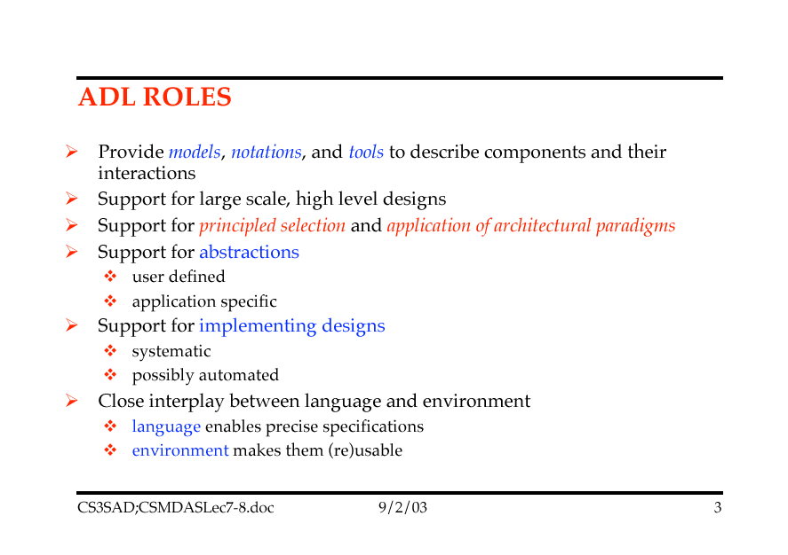

Slide 25
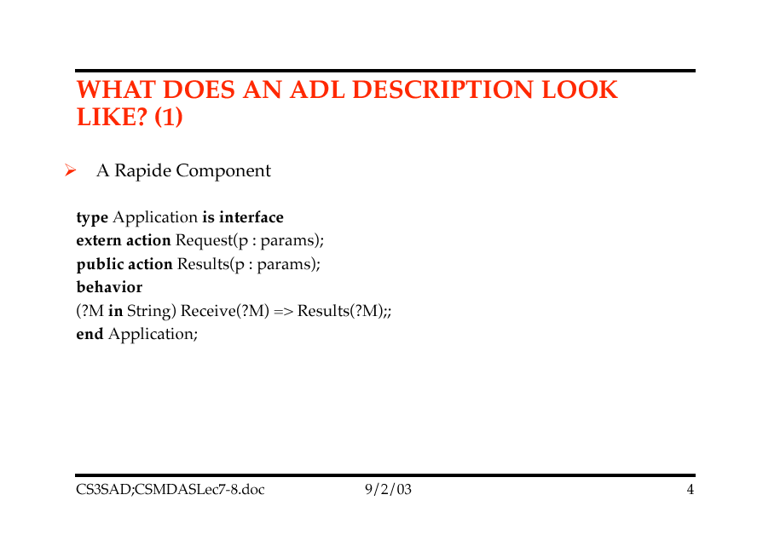

Slide 26
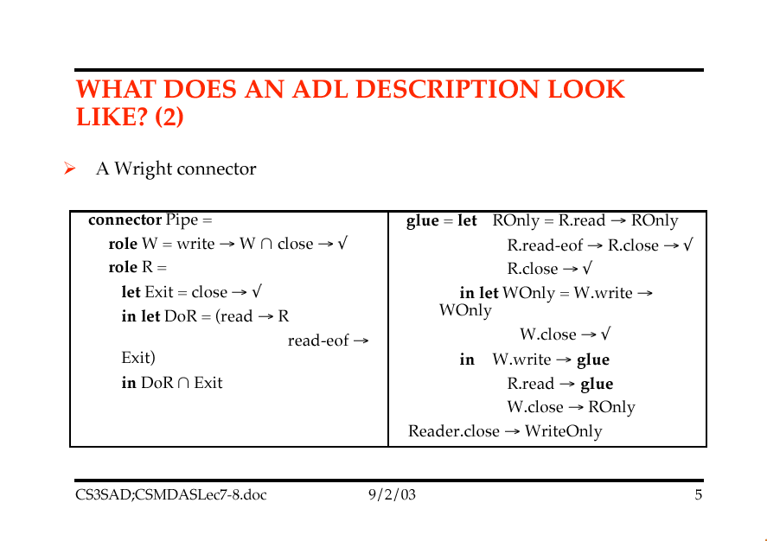

Slide 27
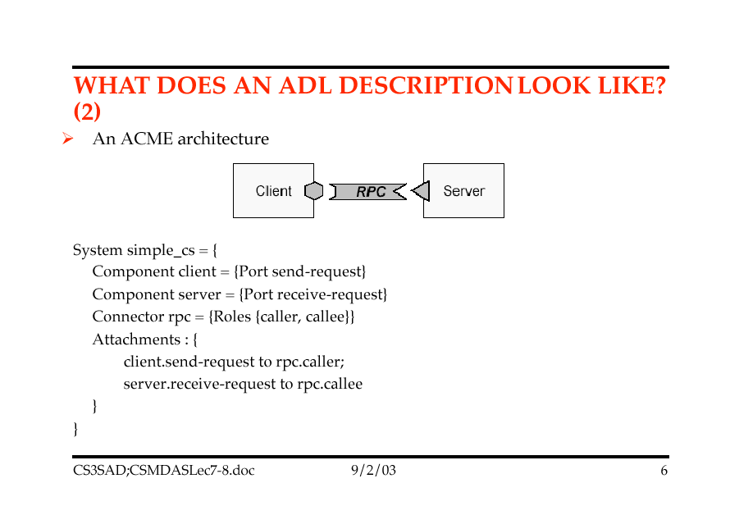

Slide 28
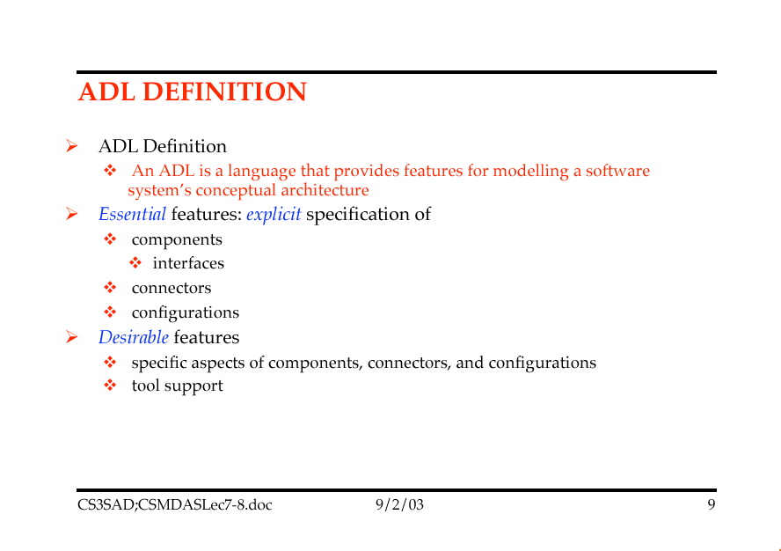

Slide 29
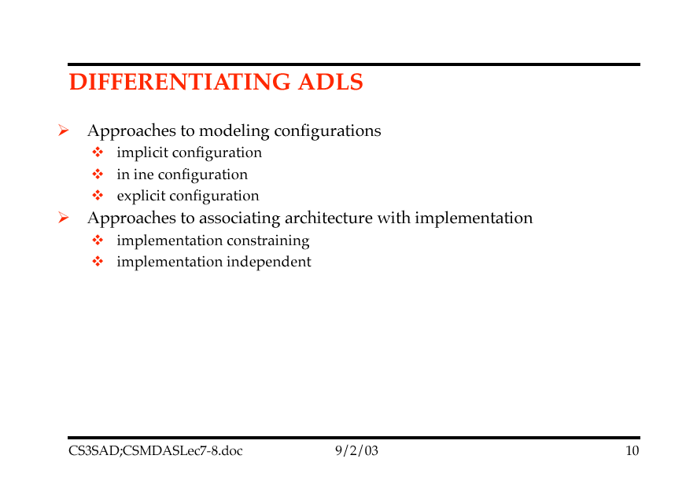

Slide 30
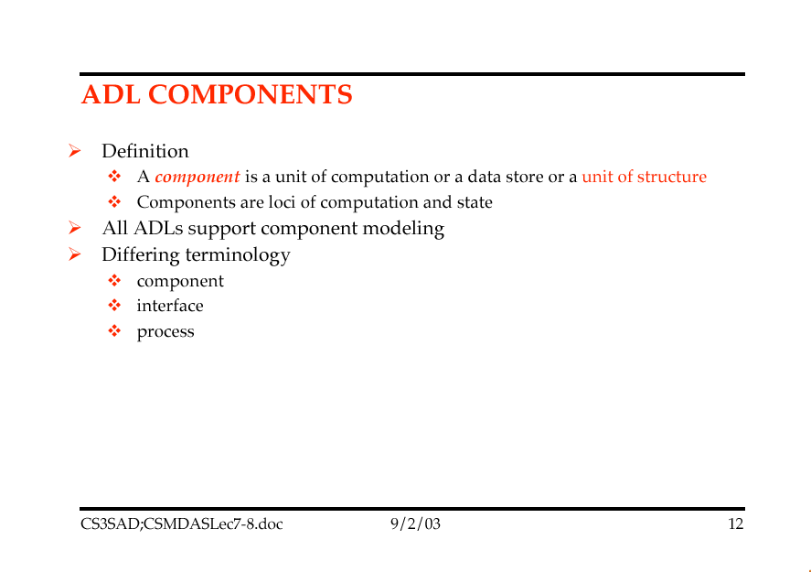

Slide 31
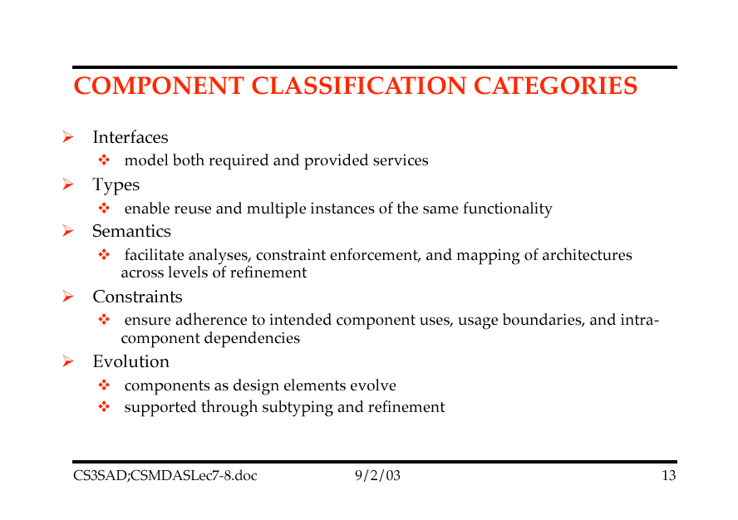

Slide 32
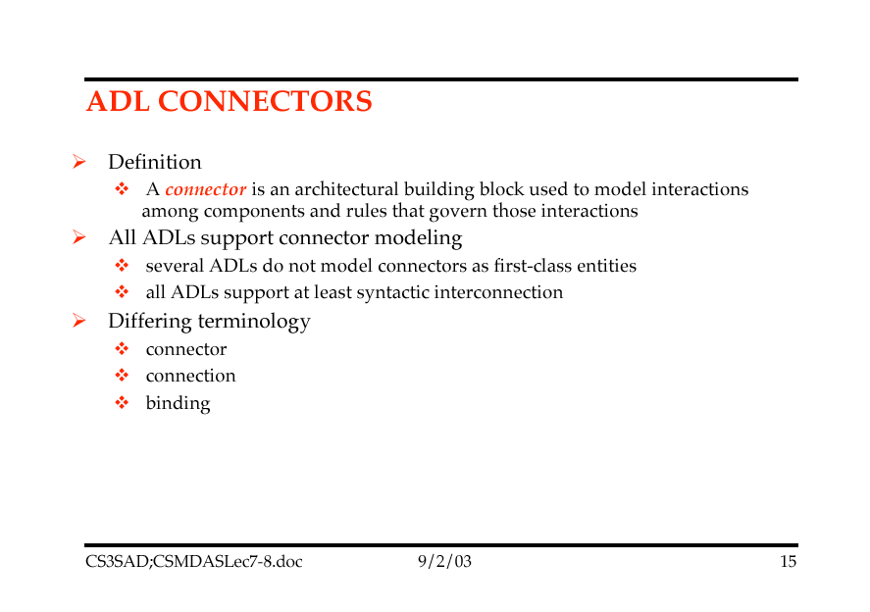

Slide 33
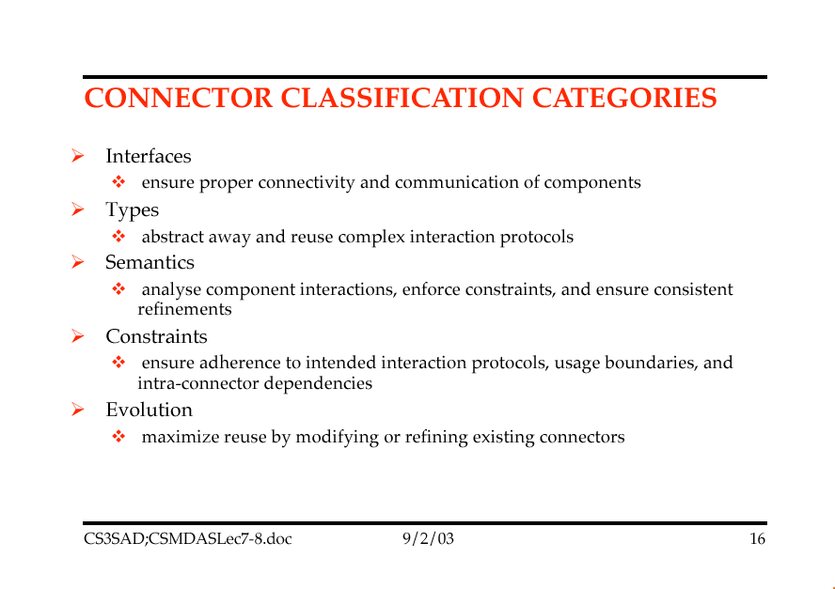

Slide 34
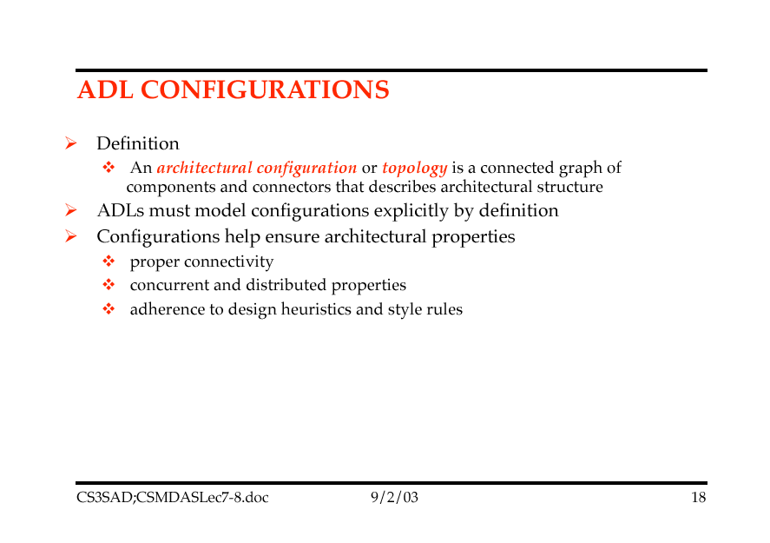

Slide 35
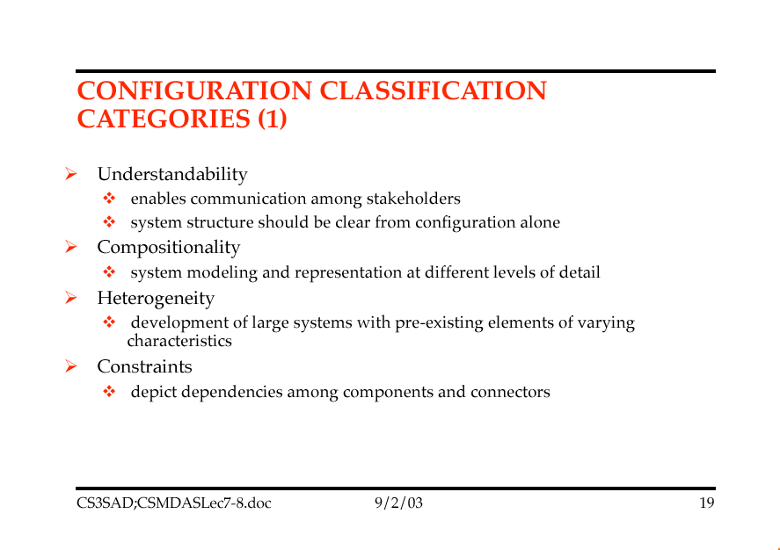

Slide 36
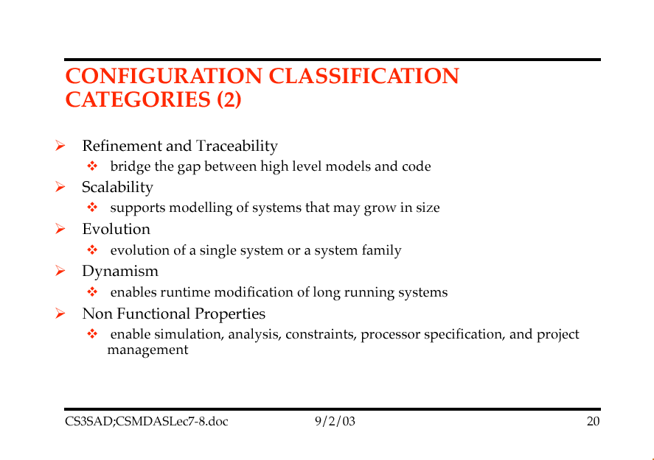

Slide 37
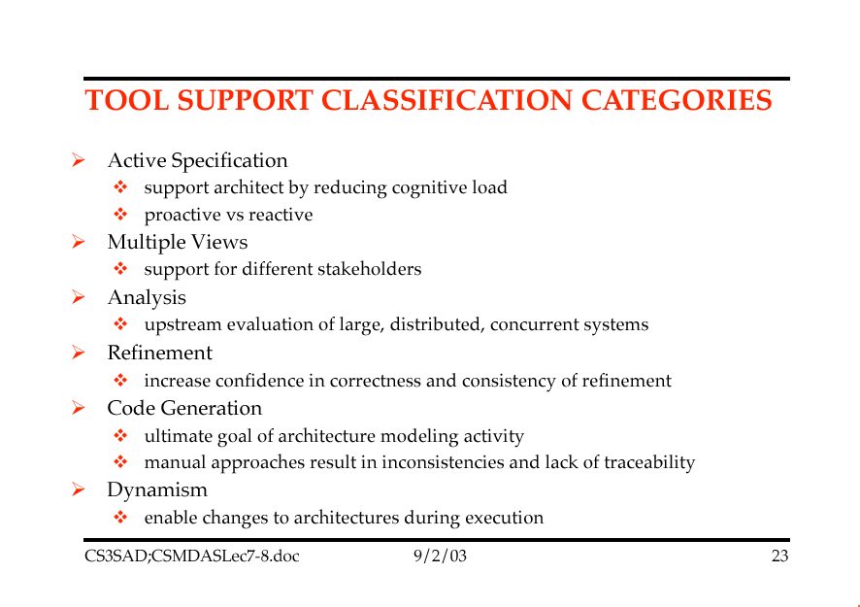

Slide 38
Architectural Description Languages
Architectural Description Languages can be evaluated or described by listing the following:
System-oriented attributes
Language-oriented attributes
Process-oriented attributes

Slide 39
ADLs: System-Oriented Attributes
How suitable is the ADL for representing a particular type of application?
How well does the ADL allow descriptions of architectural style?
What broad classes of system can have their architectures represented in the ADL?
E.g., hard real-time, distributed, embedded etc.,

Slide 40
ADL’s: Language-Oriented Attributes
Syntax and semantics formally defined?
Does the ADL define completeness for an architecture
Does the ADL support the ability to add new types of components, connectors
How easily is the software architecture description modified?
How saleable are its descriptions etc.,

Slide 41
ADL’s: Process-Oriented Descriptions
Is there a textual editor or tool for manipulating ADL text?
Is there a graphical editor?
Can the tool import information from other descriptions into the architecture?
Does the ADL support incremental refinement?
Does the ADL support comparison between two architectures?

Slide 42
Topic 7: Architectural Patterns

Slide 43
Pattern-Oriented Software Architecture
Frank Buschmann, Regine Muenier, Hans Rohnert, Peter Sommerlad, Michael Stal.1996.Patterns of Software Architecture
Presented three categories of patterns
Architectural Patterns
Design Patterns
Idoms
Have been confused with Architectural Styles
To see difference we need to look at origins of Software Patterns

Slide 44
Origins of Patterns
There are a number of primary sources for the emergence of Software Patterns
PhD work on frameworks by Eric Gamma
Contract specification by Richard Helm
Smalltalk frameworks by Brian Foote and Ralph Johnson
Software Architecture handbook by Bruce Anderson
But the patterns form originates in the built environment with the work of Christopher Alexander

Slide 45
A Brief History of Software Patterns
1989: Alexander’s ideas introduced by Kent Beck, Ward Cunningham
1991-4: OOPSLA workshops on Software Architecture
Gamma, Helm, Johnson and Vlissides meet
1993: Hillside group formed
1995: Design Patterns book published
1996: Alexander’s keynote at OOPSLA

Slide 46
Christopher Alexander
Born in Vienna, educated in Britain and the US
A leader of “post-modern” architecture
Driven by observation that most of what humanity has built since WWII has been dehumanising rubbish
Believes architecture impacts directly on our behaviour and well being
“Tall buildings make people mad”
Professional architects have failed humanity and the environment
Views are controversial even amongst architects

Slide 47
Christopher Alexander (2)
Work is represented in an 11-volume series of books (8 currently in print)
The Timeless Way of Building
A Pattern Language
The Oregon Experiment
The Linz Café
The Production of Houses
A New Theory of Urban Design
A Foreshadowing of 21st Century Art
The Mary Rose Museum
The Nature of Order
Sketches of a New Architecture
Battle: The story of a Historic Clash Between World System A and World system B

Slide 48
Christopher Alexander (3)
Also presented a critique of modern design in Notes on the Synthesis of Form (1964)
Identified cognitive complexity and the alienation of builders from users as the root of failure of modern design
Later proposed “pattern languages” as a way of recovering lost ability to design useful things
Notes:
Contrasted “unselfconscious building processes” with “selfconscious building processes”

Slide 49
Homeostatic Structure
Alexander’s criticism of modern design is rooted in the belief that we have lost the ability to create ‘homeostatic (self-adjusting) structures’
In homeostatic structure the failures of form are ‘one-offs’
The culture/tradition that supports them changes more slowly
Strongly resists all changes other than those provoked by failure
Is embodied in a culturally acquired “pattern language”
Each failure is easily accommodated, equilibrium between form and context is dynamically re-established after each ‘failure’
Notes:
The tradition is conservative unchanging and “flexes” only in response to catastrophic failures in order to provide emergency repair. Change is therefore always “one-off” and localised, whereas in self conscious building change tends to spasmodic and global.

Slide 50
Biological Forms
An individual tree is an homeostatic structure
It responds, genetically, to the local availability of sunlight and rain
Through numbers of leaves, branches
To competition
Through achieving maximum height
To wind
By bending its shape
Each individual tree’s shape fits its individual context
Notes:
Alexander believes that patterns should instill the “genetic code” that will make buildings homeostatic

Slide 51
Reasons for Modern Design Crisis
Design tradition has been decisively weakened
In face of new requirements, new materials
Feedback loop no longer immediate
Professionalisation of architecture separates designers from users
The rising control of the designer
Has an unachievable responsibility
Cognitive burden too large
Notes:
The modern dilemna is that the designer’s increased knowledge of, control of, and responsibility for their design is the very source of the problems of modern design. It is too much of a cognitive burden to deal with all the different kinds of different forces that impact with different change rates.

Slide 52
A Pattern Language
Alexander’s book: “A Pattern Language” presents 253 patterns for the built environment
Written in a standard, narrative form supported by hand-drawn sketches
Includes patterns to build alcoves, rooms, houses, towns, cities and even global society
Together the patterns form a network
A “pattern language”

Slide 53
Example of an Alexandrian pattern
“Waist High Shelf”
Proposes that every domestic home needs a “waist-high shelf”
A convenient place to deposit office keys, car keys, mobile phone etc.
Everything you don’t need at home, but do need for work
Can be implemented in a number of ways
Shelf; kitchen worktop; particular stair on stairway
Is an abstract solution to a general, recurring problem in a particular context

Slide 54
Design Patterns
Design Patterns are elements of reusable software
They provide the abstract core of solutions to problems that are seen over and over again
Notes:
They might also be considered to be the software engineering industry’s equivalent of “blacksmith design” - an attempt to deal with the fact that we are still a craft but one that lacks a Master-Apprentice culture.

Slide 55
Example of a Design Pattern (Simplified)
Example Design Pattern: State
Use when
Behaviour depends on current state or mode
When otherwise a large switch statement or long if statement would need to be used
These are difficult to maintain
Solution
Abstract state-specific behaviour into a shallow inheritance hierarchy; instantiate the appropriate state object as needed at run-time

Slide 56
State Pattern Applied
LoanStatus
{abstract}
CopyOfBook
IsbnNumber:BookCode
currentState:LoanStatus
checkOut( )
return( )
checkOut( )
return( )
CopyOfBook “holds” an instance of EITHER Available or OnLoan at run-time (as appropriate) and passes on to it the messages it receives. Available and OnLoan have different implementations of checkOut()
Available
OnLoan

Slide 57
The “Gamma Patterns”
The patterns in the Design Patterns book are sometimes called “Gamma patterns”
After the lead author, Erich Gamma
Also called GoF or Gang-of-Four patterns
They are a catalogue of 23 patterns
NOT a pattern language
Each pattern is written in a standard template form
Classified into Structural, Behavioural and Creational patterns
Links shown via a Pattern Map

Slide 58
The Gamma Pattern Template
Intent
A.K.A.
Motivation
Applicability
Structure
Participants
Collaborations
Consequences
Implementation
Sample Code
Known Uses
Related Patterns
Notes:
A pattern is also a piece of literature for communicating design ideas. Patterns are written down in a standard form. These headings are the template for the GOF patterns.Most are much smaller (5-6 headings)

Slide 59
Map of the Gamma Patterns

Slide 60
Shared Values of People Documenting Software Patterns
Success is more important than novelty
good patterns are discovered not invented
Emphasis on writing down and communicating “best practice” in a clear way
most patterns use a standard format - a patterns template which combines literary and technical qualities
“Qualitative validation of knowledge”
effort is to describe concrete solutions to real problems, not to theorise

Slide 61
Shared Values of People Documenting Patterns (contin.)
Good patterns arise from practical experience
Every experienced developer has patterns that we would like them to share. We do this in Pattern Writers’ workshops
Respect and recognition for the human dimension of software development
Full recognition that design is a creative, human activity
Full respect for previous gains and conquests

Slide 62
Characteristics of Software Design Patterns (e.g. Gamma et al)*
Problem, not solution-centred
Focus on “non-functional” aspects
Discovered, not invented
Complement, do not replace existing techniques
Proven record in capturing, communicating “best practice” design expertise
*Gamma E., Helm R., Johnson R., Vlissides J. 1994.Design Patterns- Elements of Reusable Object-Oriented Software. Addison-Wesley
Notes:
Gamma, Helm, Johnson and Vlissides are often called “The Gang of Four” and thir patterns are aronymously called GOF patterns.
There are 23 GOF or Gamma patterns in the book, categorised into Creational, Structural and Behavioural patterns.In this presentation we will look in depth at just one of these.
There are many other kinds of patterns and pattern books, too. The Plop (Pattern Languages of Program Design) conferences have already published two volumes and are currently editing a third. Siemens AG in Germany have published patterns.
Besides Design Patterns there are also Analysis patterns, Process and Organisation patterns, Architectural style patterns etc, and language specific patterns for programming in C++, Smalltalk and Java.
But Design Patterns are the best understood, and the GOF patterns the most well known.

Slide 63
Architectural Patterns
“An architectural pattern expresses a fundamental organising structural organisation schema for software systems. It provides a set of predefined subsystems, specifies their responsibilities, and includes rules and guidelines for organising the relationships between them”

Slide 64
Architectural Patterns
Buschmann et al., present a catalogue that includes 8 architectural patterns in 4 categories
“From Mud to Structure”
Layers, Pipes and Filters, Blackboard
Distributed Systems
Broker
Interactive Systems
Model View Controller, Presentation-Abstraction-Controller
Adaptable Systems
Microkernel, Reflection

Slide 65
The Model-View-Controller Pattern (continued)
View
Model
Controller
M-V-C originated with Smalltalk-80
- Informs the entire architecture of modern Smalltalk
environments
Microsoft’s Document-View architecture is an instance of M-V-C
Model = Document, View = View
-So where is the Controller? (answer: it is MS Windows!)

Slide 66
Layers Pattern: Example
FTP protocol
FTP
FTP
TCP/IP protocol
TCP protocol
TC P
TC P
IP protocol
I P
I P
Ethernet protocol
Ethernet
Ethernet
Physical connection

Slide 67
Layers Pattern
Context
large system needing decomposition
Problem
How to structure systems that contain a mix of high and low-level functionality
Solution
Conceptually layer the system, from level 0 upwards

Slide 68
Layers Pattern: Structure
Class
LayerJ
Responsibility
Collaborator
Provides services to Layer J+1
Delegates subtasks to Layer J-1
Layer J-1

Slide 69
Layers Pattern: Consequences
Benefits
Reuse of Layers
Support for standardisation
Localisation of dependencies
Exchangeability
Liabilities
Cascades of Changing Behaviour
Lower Efficiency
Unnecessary work
Difficulty of getting ‘granularity’ right

Slide 70
Layers Pattern: Variants
Relaxed Layer System
A.k.a. ‘open’ layered system
Layer can talk to any layer below it
In ‘closed’ layer systems can talk only to the layer immediately below
Gains in performance, flexibility
Loses maintainability
Layering through Inheritance
Abstract classes at Layer 0 etc.,

Slide 71
Broker Pattern
Context
Distributed, possibly heterogeneous system of independent co-operating “components”
Problem
How to partition functionality to deliver a set of decoupled, interoperating components
Solution
Introduce a Broker component to decouple clients and servers

Slide 72
Broker Pattern:Structure
Broker
Server-side Proxy
Client-side Proxy
Client-side Proxy
main_event_loop() update_repository() register_service( ) acknowledgement() find_server() find_client() forward_request() forward_response()
transfers
message
transfers
message
pack-data() unpack_data() call_service( ) send_response( )
pack-data() unpack_data() send_request( ) return( )
pack-data() unpack_data() send_request( ) return( )
1
1..*
1..*
1
1
1..*
calls
1..*
1
1
calls
calls
uses API
0..1
uses API
1..*
1
1
1..*
Bridge
Server
Client
pack_data() unpack_data( ) forward_message() transmit_message()
initialise() enter_main_loop() run_service( ) use_Broker_API
call_server() start_task( ) use_Broker_API

Slide 73
Broker Pattern: Variants
Direct Communication Broker System
Clients communicate directly with servers, broker identifies the communication channel
Message Passing Broker System
Servers use type of message to determine action
Trader System
Client-side servers provide service ids rather than server ids
Adapter Broker System
Callback Broker System
Reactive, event-driven model; makes no distinction between clients and servers

Slide 74
Broker Pattern: Consequences
Benefits
Location transparency
Changeability/Extensibility of components
Portability
Interoperability between Broker Systems
Reusability
Testing and Debugging
Liabilities
Restricted efficiency
Lower fault tolerance
Testing and Debugging

Slide 75
Presentation-Abstraction-Control Pattern
Context
Interactive systems with the help of agents
Problem
Partitioning of interactive systems horizontally and vertically
Solution
Structure the solution as a tree-like hierarchy of PAC agents

Slide 76
Presentation-Abstraction-Control Pattern: Structure
Data repository
Access to data
Top-level PAC agent
Intermediate-level PAC agent
Spreadsheet
View Co-ordinator
pie chart
seat distribution
bar chart
Bottom-level PAC agents

Slide 77
Presentation-Abstraction-Control Pattern: Variants
PAC agents as active objects
PAC agents as processes

Slide 78
Presentation-Abstraction-Control Pattern: Consequences
Benefits
Separation of Concerns
Support for Change/Extension
Support for multi-tasking
Liabilities
Increased system complexity
Complex control components
Efficiency
Restricted applicability

Slide 79
Summary
Patterns
Open, informal, abstract solutions to a general, recurring problem in a particular context
Capture “best practice” experience of design
Can be organised as Catalogues or as Pattern Languages
Differ from ABAS which are closed, formal composable abstractions
Architectural Patterns are a sub-category of patterns
To do with “gross structure”
But arguably ALL patterns are architectural

Slide 80
Topic 8: Domain-Specific Software Architecture

Slide 81
Domain-Specific Software Architecture (DSSA)
“The relationships between functions in programs for a software domain
This is also known as a reference model, functional partitioning, meta-model, logical model, . . .
Why do we want this?
1. To build better: tools, specification languages, domain-specific reusable components, application frameworks, product families.
2. To understand better. Software problems are very complex. A DSSA is ready-made, reusable domain analysis, problem decomposition.

Slide 82
Example DSSA: Architecture (the real kind)
The problem: “obtain an artificial environment for some human activity”.
Specific instances of this problem: a house, an apartment, a store, a warehouse, a jail, a paint factory.
User: wants the building
Constructor: builds the building
Requirements: two-car garage, roof will last 30 years, doorways have 5 meter clearance, ...
Specifications: plans/blueprints

Slide 83
Architecture (the real kind) - 2
These instances of buildings have much in common and can reuse analyses:
• Functional requirements: how many people should this building hold? how should it be heated/cooled? how should the parts be connected?
• Non-functional requirements: how easy is it to add an addition? how secure should it be? how many years should it last?

Slide 84
Architecture (the real kind) - 3
These instances can also reuse designs/components:
• house plans
• trusses
• door-knobs
How does the reuse of designs/components affect the quality of the resulting building?

Slide 85
The DSSA Solution
Three kinds of knowledge:
• how to decompose the composite problem into component problems
• how to solve each of the component problems
• how to compose the individual solutions of the component problems into a solution of the composite problem
This knowledge is not trivial. The ease of the solution to an instance of a class depends on the existence of a DSSA for that class.

Slide 86
Solving Problems with DSSAs
Decompose the problem into the language of the DSSA: the atomic actions (install wiring, generate an attribute evaluation module, create a cache manager, ...).
Different atoms will be required for different end-products.
The DSSA does not specify an inventory that all products must use.
Some atoms may exist as off-the-shelf components.
Some may need to be tailor-made.
A DSSA focuses requirements/design decisions; highlights changes from canonical solutions.

Slide 87
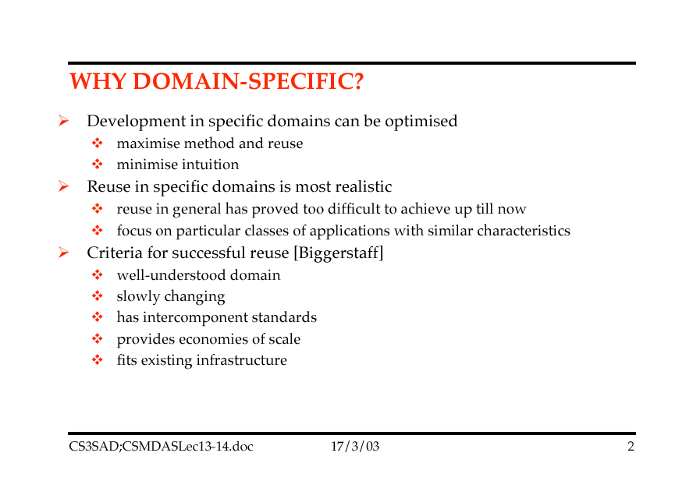

Slide 88
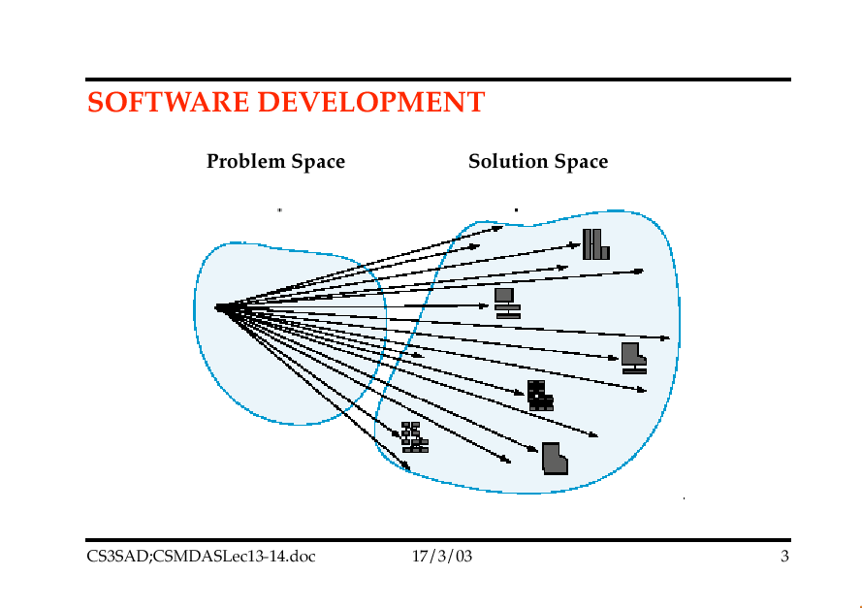

Slide 89
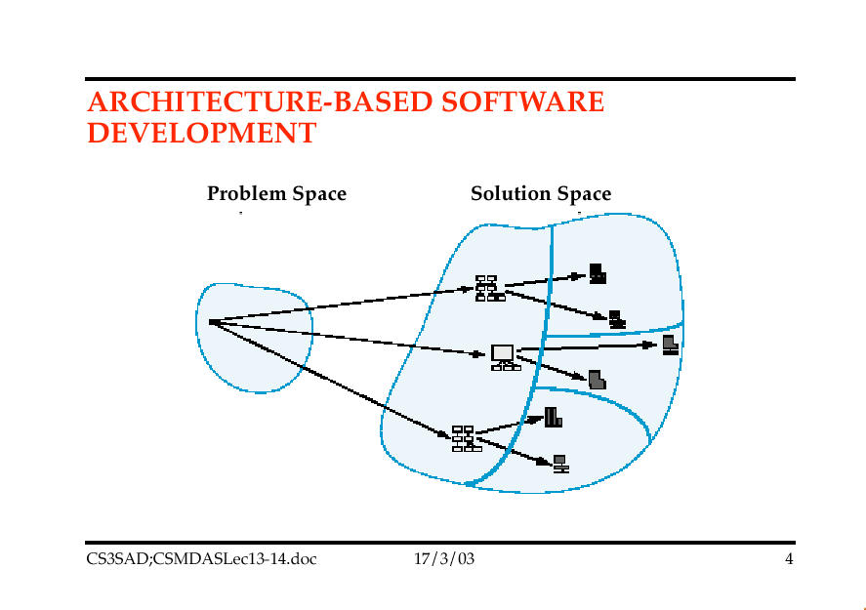

Slide 90
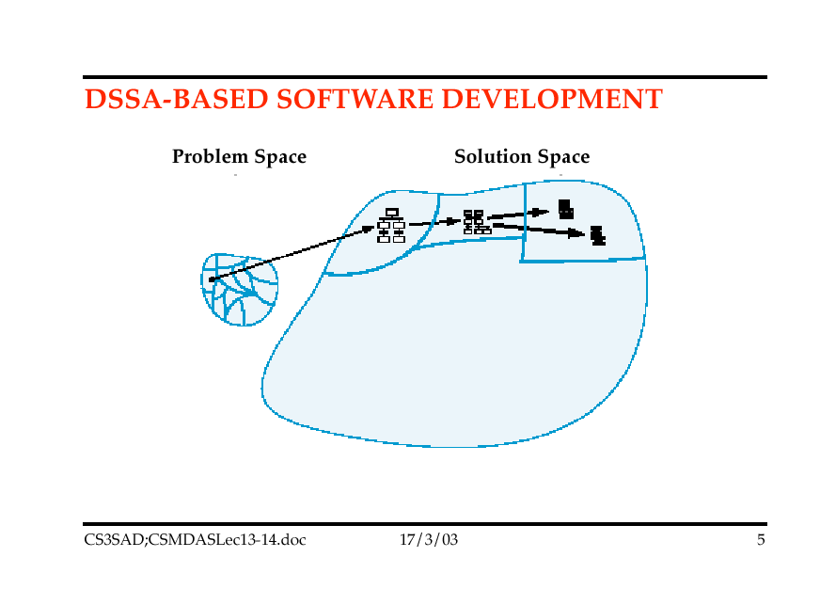

Slide 91
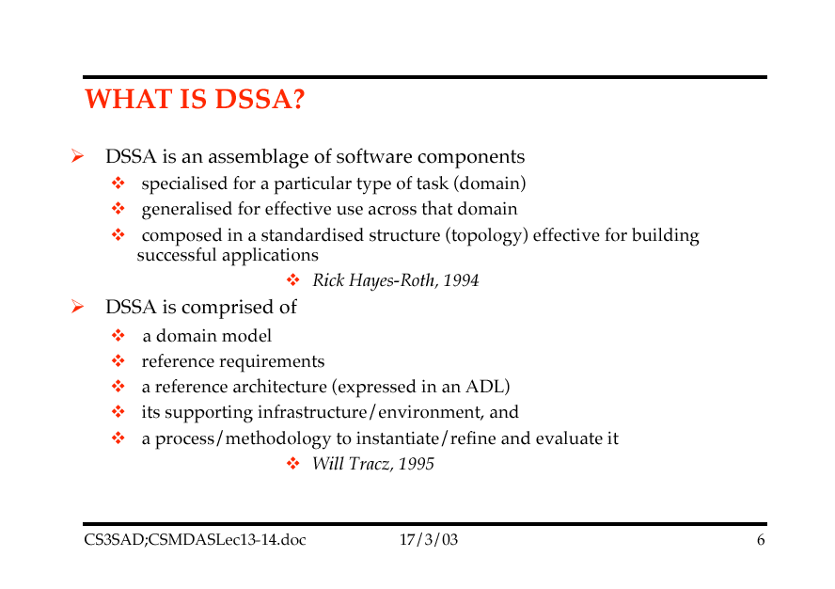

Slide 92
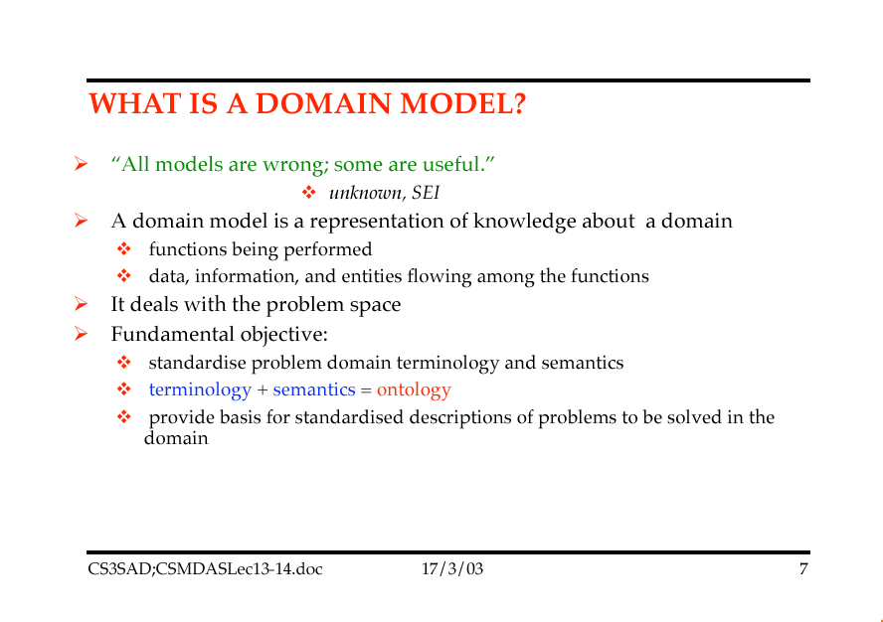

Slide 93
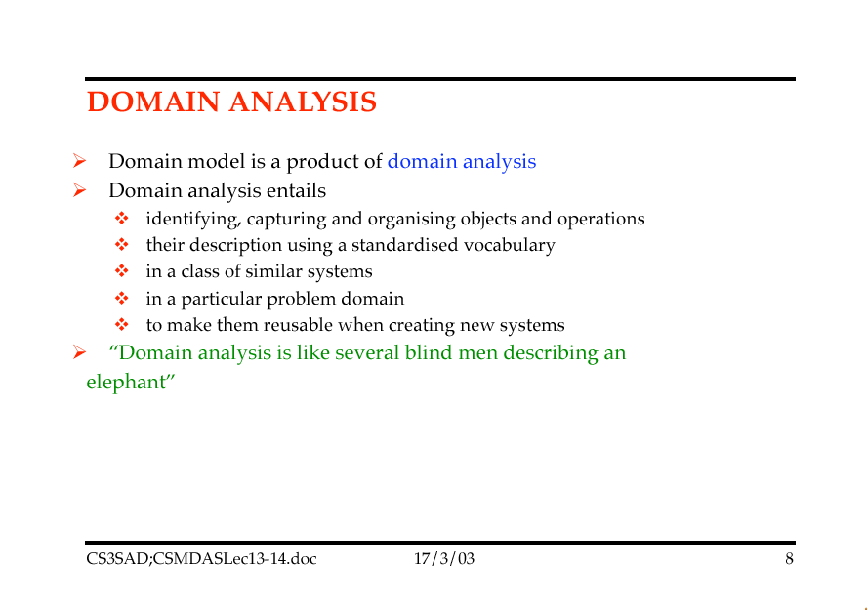

Slide 94
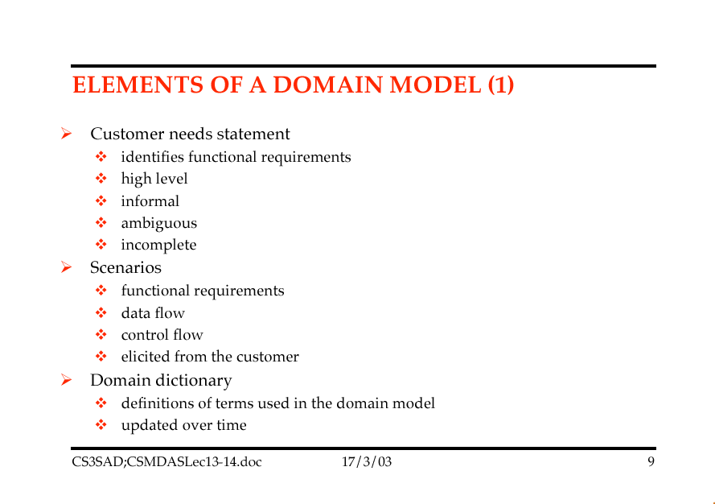

Slide 95
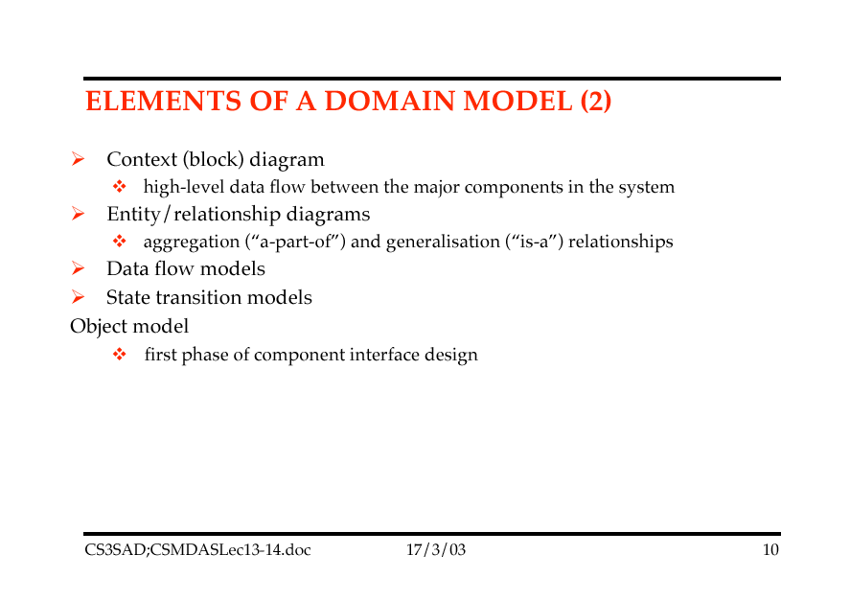

Slide 96
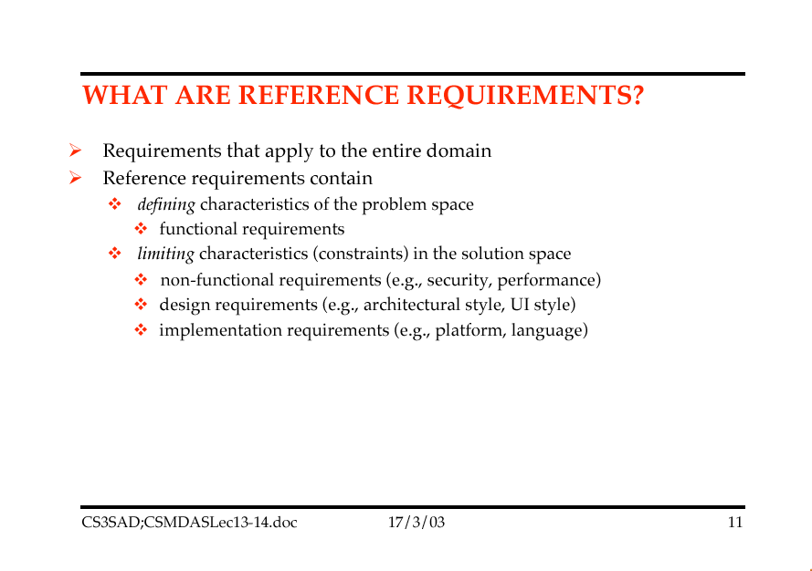

Slide 97
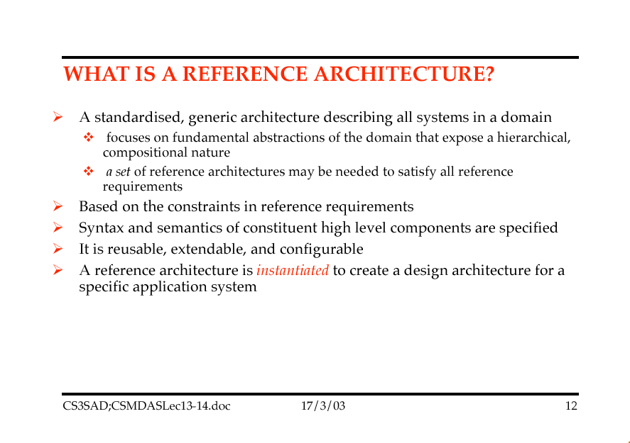

Slide 98
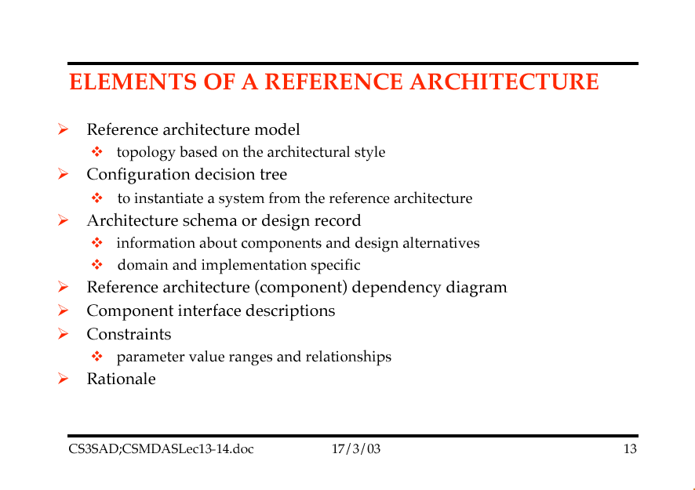

Slide 99
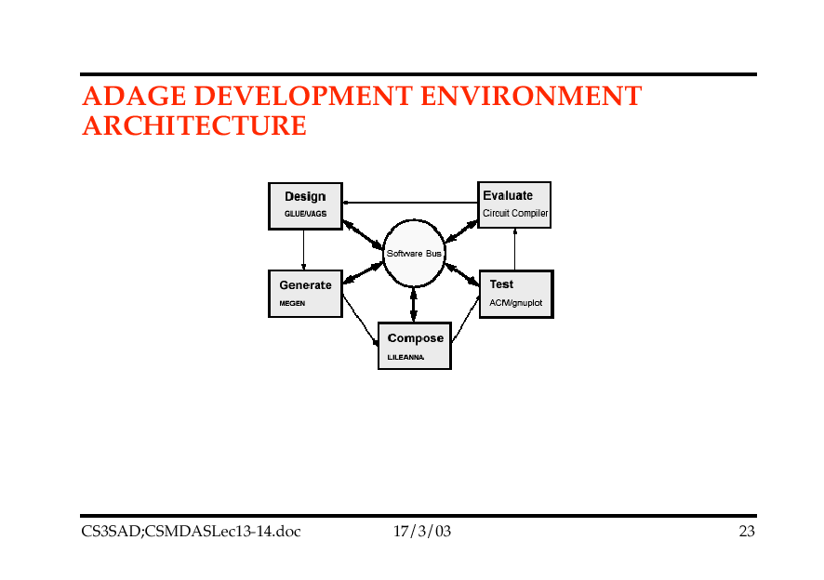

Slide 100
Topic 9: Discipline of Software Architecture

Slide 101
Software Architecture
Dan Bredemeyer outlines Software Architecture in the following way:
Architecture: Addressing “What is SW Architecture?; architecture views, patterns, styles, component specs., interfaces etc.,
Architecting: How do I create, recapture or migrate an architecture?: modelling, documenting, assessing.
Architects: What are the roles, responsibilities and skills of architects?
Architecture Strategy: Why do architecture? And When?: competitive differentiation
Architectural context: Where in the organisation is architecture done?
Notes:
Dan Bredemeyer is formerly of Hewlett Packard, now of Bredemeyer Consulting, http://www.bredemeyer.com/

Slide 102
Bredemeyer’s Software Architecture Model (1)
guide architects
Meta-Architecture
Conceptual Architecture
Architecture
Logical Architecture
guide designers
Execution Architecture
Architecture Guidelines and Policies

Slide 103
Bredemeyer’s Software Architecture Model (2)
Meta-Architecture
Architectural vision, principles, styles, key concepts and mechanisms
Focus: high-level decisions that will strongly influence the structure of the system; rules certain structural choices out, and guides selection choices and tradeoffs among others
Architecture
Structures and relationships, static and dynamic views, assumptions and rationale
Focus: decomposition and allocation of responsibility, interface design, assignment to processes and threads
Architecture Guidelines and Policies
Use model and guidelines: policies, mechanisms and design patterns; frameworks, infrastructure and standards
Focus: guide engineers in creating designs that maintain the integrity of the architecture

Slide 104
Bredemeyer’s Software Architecture Model (3)
Conceptual Architecture
Architecture diagram, CRC-R cardsFocus: identification of components and allocation of responsibilities to components
Logical Architecture
Updated Architecture diagram (showing interfaces), Focus: design of component interactions, connection mechanisms and protocols; interface design and specification; providing contextual information for component users
Execution Architecture
Process view (shown on Collaboration Diagrams)Focus: assignment of the runtime component instances to processes, threads and address spaces; how they communicate and co-ordinate; how physical resources are allocated to them

Slide 105
Conceptual Architecture
Clerk dialog
Balance books
Receive payments
Enter sales
Accounts
Customers
Abstract, system-wide view
Basis for communication

Slide 106
Logical Architecture
Context_Manager
Application #1
ContextManager
ContextData
ContextParticipant
“Blueprint”: precise, unambiguous, actionable
Basis for supplier/client contract

Slide 107
Execution Architecture
server
<<process>>
r:ReservationAgent
{location = reservation server}
CORBA ORB
client
<<process>>
t:TripPlanner
{location = client}
<<process>>
h:HotelAgent
{location = hotel server}
<<process>>
t:TicketingManager
{location = airline server}
Configuration of components at run-time
Basis for early system tuning

Slide 108
Process Overview
Init/Commit
System
Structuring
Architectural
Requirements
Architectural
Validation
Deployment

Slide 109
How to Create a Good Architecture
Elicit stakeholder goals
Ensure architecture supports what is valued and scopes out what is not
Bredemeyer creates Context Maps, Stakeholder Profiles for documentation
Drives creation of principles, selection of architectural styles, and selection/creation of mechanisms in “meta-architecture phase”
Functionality goals are starting points for Use Cases
Quality goals are starting points for non-functional requirements specification

Slide 110
Functionality Goals
Functional requirements capture the intended behaviour of the system
Use Cases capture who (actor) does what (interaction) with the system for what purpose (goal) without dealing with system internals
A Use Case defines a goal-oriented set of interactions between external actors and the system under consideration

Slide 111
Quality Goals
Qualities are properties or characteristics of the system that its stakeholders care about and hence will affect their degree of satisfaction with the system.
Explicit, documented qualities are needed to:
Define architectures so that they achieve required qualities
Make tradeoffs
Form a basis for comparing alternatives
Enhancing communication within architecture team and between architects and stakeholders
Evaluate architectures to ensure compliance

Slide 112
Init/Commit Summary
Gain Management Sponsorship
Purpose: Ensure management support
Activities: Create/communicate the architectural vision showing how it contributes to long-term success
Checks: Resources? Full-time architect-team members? Management championship?
Build the Architecture team
Purpose: ensure a cohesive and productive team
Activities: Use arch. vision to build team alignment; assess team capabilities and needs; establish team operating model
Checks: strong accepted leader? Collaborative, creative team? Effective decision-making?

Slide 113
Architectural Requirements Summary
Capture Context, Goals and Scope
Ensure architecture is aligned to business strategy and directions, and anticipates market and technology changes
Capture Functional Requirements
Document, communicate and validate the intended behaviour of the system
Capture Non-Functional Requirements

Slide 114
System Structuring Summary
Create the Meta-Architecture
Make strategic architectural choices to guide the architecting effort
Create the Conceptual Architecture
Create conceptual
to communicate the architecture to managers, project managers, developers and users
Create the Logical Architecture
Create detailed architectural specs. In a way that is directly actionable

Slide 115
Validation Summary
Validate the Architecture
Assess the architecture to validate that it meets the requirements and identify issues and areas for improvement early
Construct prototypes or proof-of-concept demonstrators or skeletal architecture to validate communication and control mechanisms
Conduct reviews
Conduct architectural assessments (e.g., SAAM Action Guide)

Slide 116
Deployment Summary
Build Understanding
Help all developers understand the architecture, its rationale, and how to use it.
Help managers understand its implications for organisational success, work assignments etc.,
Ensure Compliance
Ensure designs and implementations adhere to the architecture and do not cause “architectural drift”
Evolve the Architecture
Ensure the architecture remains current

Slide 117
Evolutionary Technical Process
 | Pass1 From Business Strategy to Architectural Strategy | Pass 2 From Strategy to Concept | Pass 3 From Concept to Specification | Pass 4 From Specification to Execution | Pass 5 From Execution to Deployment
Architectural Requirements | Context Goals Scope | Use cases Qualities | Refine Use Cases | Concurrency | Developer needs
System Structuring | Meta-architecture | Conceptual Architecture | Logical Architecture | Execution Architecture | Architectural Guidelines
Architectural Validation | Reasoned arguments | Impact Analysis | Estimates | Prototypes

Slide 118
Topic 10: Software Architecture and the UML
*Adapted from “Software Architecture and the UML” by Grady Booch

Slide 119
The Value of the UML
Is an open standard
Supports the entire software development lifecycle
Supports diverse applications areas
Is based on experience and needs of the user community
Supported by many tools

Slide 120

Creating the UML
UML 1.3
OMG Acceptance, Nov 1997
Final submission to OMG, Sep ‘97
UML 1.1
public
feedback
First submission to OMG, Jan ´97
UML partners
UML 1.0
Web - June ´96
UML 0.9
OOPSLA ´95
Unified Method 0.8
Other methods
Booch method
OMT
OOSE

Slide 121

Contributions to the UML
Harel
Meyer
Gamma, et al
Statecharts
Before and after
conditions
Frameworks and patterns,
HP Fusion
Booch
Operation descriptions and
message numbering
Booch method
Rumbaugh
Embley
OMT
Singleton classes and
high-level view
Jacobson
Wirfs-Brock
OOSE
Responsibilities
Shlaer - Mellor
Odell
Object lifecycles
Classification

Slide 122
Overview of the UML
The UML is a language for
visualising
specifying
constructing
documenting
the artifacts of a software-intensive system

Slide 123
Diagrams in UML
State
Diagrams
State
Diagrams
Class
Diagrams
Use Case
Diagrams
Scenario
Diagrams
Use Case
Diagrams
State
Diagrams
Scenario
Diagrams
Use Case
Diagrams
State
Diagrams
Statechart
Diagrams
Object
Diagrams
Scenario
Diagrams
State
Diagrams
Scenario
Diagrams
State
Diagrams
Collaboration
Diagrams
Component
Diagrams
Models
Component
Diagrams
Use Case
Diagrams
Component
Diagrams
Use Case
Diagrams
Deployment
Diagrams
Sequence
Diagrams
Activity
Diagrams

Slide 124
Requirements
Structure
e.g., system hierarchies, interconnections
Behavior
e.g., function-based behaviors, state-based behaviors
Properties
e.g., parametric models, time variable attributes
Requirements
e.g., requirements hierarchies, traceability
Verification
e.g., test cases, verification results

Slide 125
Evaluation Criteria
Ease of use
Unambiguous
Precise
Complete
Scalable
Adaptable to different domains
Capable of complete model interchange
Evolvable
Process and method independent
Compliant with UML 2.0 metamodel
Verifiable

Slide 126
Design Goals
Satisfy UML for SE RFP requirements
6.5 Mandatory req’ts, 6.6 Optional req’ts
Reuse UML 2.0 to the extent practical
select subset of UML 2.0 reusable for SE apps
parsimoniously add new constructs and diagrams needed for SE
Incrementally grow the language
prevent scope and schedule creep
take advantage of SE user feedback as language evolves via minor and major revisions

Slide 127
UML 2.0 Support for SE
Allows for more flexible System, Subsystem and Component representations
Structural decomposition
e.g., Classes, Components, Subsystems
System and component interconnections
via Parts, Ports, Connectors
Behavior decomposition
e.g., Sequences, Activities, State Machines
Enhancements to Activity diagrams
e.g., data and control flow constructs, activity partitions/swim lanes

Slide 128
UML 2.0 Support for SE (cont.)
Enhancements to Interaction diagrams
e.g., alternative sequences, reference sequences, interaction overview, timing diagrams
Support for information flows between components
Improved Profile and extension mechanisms
Support for complete model interchange, including diagrams
Compliance points and levels for standardizing tool compliance
Does not preclude continuous time varying properties
especially important for SE applications

Slide 129
UML 2.0 Diagram Taxonomy

Slide 130
Diagrams
A diagram is a view into a model
Presented from the aspect of a particular stakeholder
Provides a partial representation of the system
Is semantically consistent with other views
In the UML, there are nine standard diagrams
Static views: use case, class, object, component, deployment
Dynamic views: sequence, collaboration, statechart, activity

Slide 131
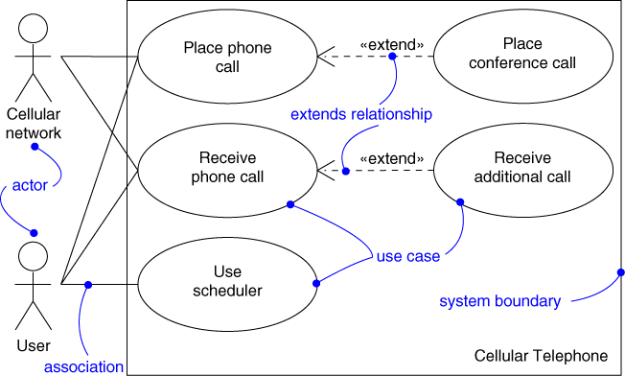
Use Case Diagram
Shows a set of use cases and actors and their relationships

Slide 132
Use Case Diagram
Captures system functionality as seen by users
Built in early stages of development
Purpose
Specify the context of a system
Capture the requirements of a system
Validate a system’s architecture
Drive implementation and generate test cases
Developed by analysts and domain experts

Slide 133
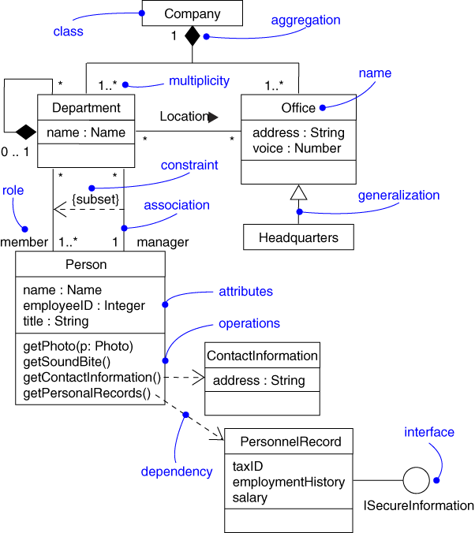
Class Diagram
Shows a set of classes, interfaces, and collaborations and their relationships

Slide 134
Class Diagram
Captures the vocabulary of a system
Addresses the static design view of a system
Built and refined throughout development
Purpose
Name and model concepts in the system
Specify collaborations
Specify logical database schemas
Developed by analysts, designers, and implementers

Slide 135
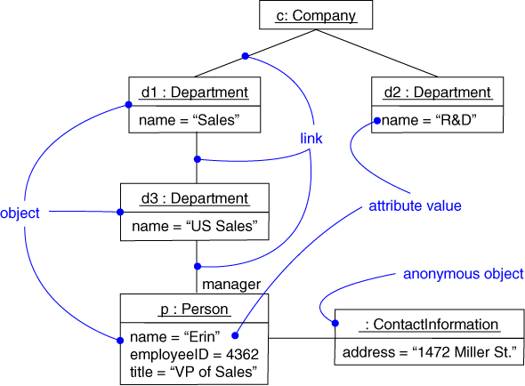
Object Diagram
Shows a set of objects and their relationships

Slide 136
Object Diagram
Represents static snapshots of instances of the things found in class diagrams
Addresses the static design view or static process view of a system
Built during analysis and design
Purpose
Illustrate data/object structures
Specify snapshots
Developed by analysts, designers, and implementers

Slide 137
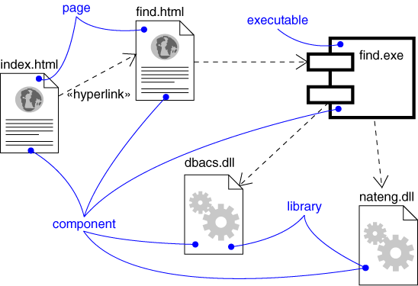
Component Diagram
Shows the organisations and dependencies among a set of components

Slide 138
Component Diagram
Addresses the static implementation view of a system
Built as part of architectural specification
Purpose
Organise source code
Construct an executable release
Specify a physical database
Developed by architects and programmers

Slide 139
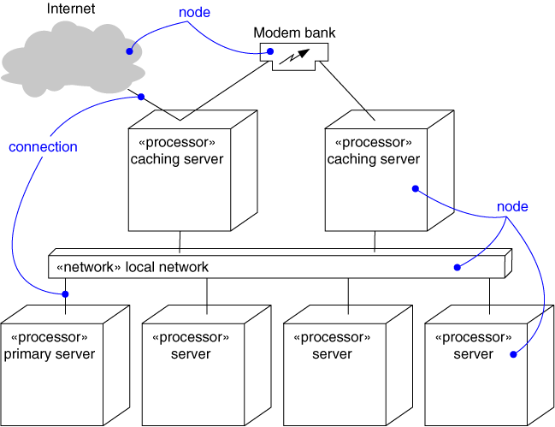
Deployment Diagram
Shows the configuration of run-time processing nodes and the components that live on them

Slide 140
Deployment Diagram
Captures the topology of a system’s hardware
Built as part of architectural specification
Purpose
Specify the distribution of components
Identify performance bottlenecks
Developed by architects, networking engineers, and system engineers

Slide 141
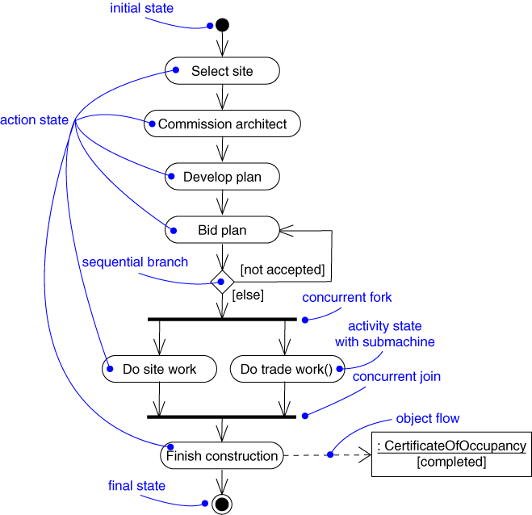
Activity Diagram
Shows the flow from activity to activity within a system

Slide 142
Activity Diagram
Captures dynamic behavior (activity-oriented)
A special kind of statechart diagram
Purpose
Model the function of a system
Model the flow of control among objects
Model business workflows
Model operations

Slide 143
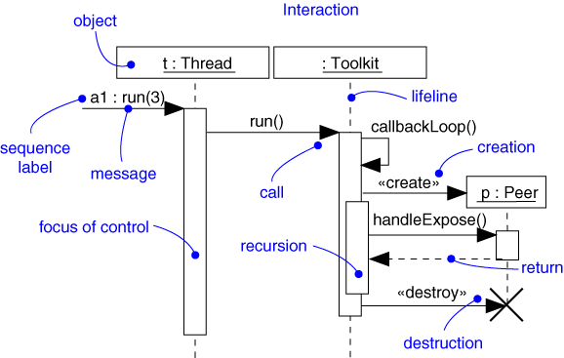
Sequence Diagram
Emphasises the time-ordering of messages

Slide 144
Sequence Diagram
Captures dynamic behavior (time-oriented)
A kind of interaction diagram
Purpose
Model flow of control
Illustrate typical scenarios

Slide 145
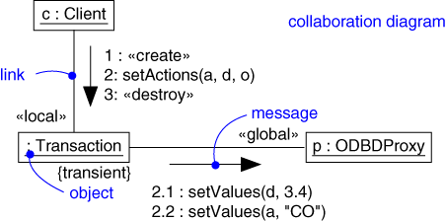
Collaboration Diagram
Emphasises the structural organisation of the objects that send and receive messages

Slide 146
Collaboration Diagram
Captures dynamic behavior (message-oriented)
A kind of interaction diagram
Purpose
Model flow of control
Illustrate coordination of object structure and control

Slide 147
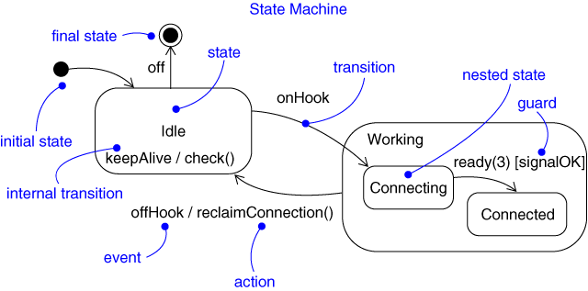
Statechart Diagram
Shows a state machine, consisting of states, transitions, events, and activities

Slide 148
Statechart Diagram
Captures dynamic behavior (event-oriented)
Purpose
Model object lifecycle
Model reactive objects (user interfaces, devices, etc.)

Slide 149
Architecture and the UML
Design View
Implementation View
Classes, interfaces,
collaborations
Use cases
Components
Use Case View
Process View
Deployment View
Active classes
Nodes
Organisation
Package, subsystem
Dynamics
Interaction
State machine

Slide 150
UML Software Development Life Cycle
Use-case driven
use cases are used as a primary artifact for establishing the desired behavior of the system, for verifying and validating the system’s architecture, for testing, and for communicating among the stakeholders of the project
Architecture-centric
a system’s architecture is used as a primary artifact for conceptualising, constructing, managing, and evolving the system under development

Slide 151
UML Software Development Life Cycle
Iterative
one that involves managing a stream of executable releases
Incremental
one that involves the continuous integration of the system’s architecture to produce these releases

Slide 152
Lifecycle Phases
Inception
Elaboration
Construction
Transition
time
Inception Define the scope of the project and develop business case
Elaboration Plan project, specify features, and baseline the architecture
Construction Build the product
Transition Transition the product to its users

Slide 153
Topic 11: Architecture and Component-Based Development

Slide 154
Architectural Mismatch
The biggest single problem for Component-Based Development is “architectural mismatch”
A component created for one context won’t work in another
Recent work by John Daniels and John Cheeseman about specifying components addresses this problem

Slide 155
Component Concepts

Slide 156
Component Concepts
Component Interface
How to use the component
Component Specification
How to build the component
Component Implementation
Software that meets a component specification
Installed Component
Executable
Component Object
Instantiation of a component

Slide 157
Problems with Interfaces
The operational interface of a component is a list of operations and their signatures
But this tells you how to USE a component…
E.g., what legal messages to send
..but not how it will behave
Programming syntax can’t tell us, we need semantic interfaces
Therefore we need to separate out the notion of a Component Interface from a Component Specification

Slide 158
Two distinct contracts

Slide 159
Interfaces v Component Specs.
Component Interface
Represents usage contract
Provides a list of operations
Defines underlying logical information model specific to that interface
Specifies how operations affect or rely on the information model
Describes local effects only
Component Specification
Represents the realisation contract
Provides a list of supported interfaces
Defines the un-time unit
Defines the relationships between the information models of different interfaces
Specifies how operations should be implemented in terms of usage of other interfaces

Slide 160
Two Levels of Component Interfaces
Cheeseman and Daniels propose two basic levels of components/interfaces…
System Interfaces
Derived from use cases
One system interface supporting one UI dialog type
E.g., ‘Make Reservation’ dialog type which uses ‘IMakeReservation’ System Interface
Use Case steps -> individual operations
Core Business Interfaces
Represent fundamental services that support system use cases
Requires identifying <<core types>>

Slide 161
An Architecture for CBD
“Front-end”
<<dialog type>>
GUI
“System” level
<<business type>>
Room
<<business type>>
RoomType
<<core type>>
Hotel
“Core” or Fundamental services

Slide 162
How to Design a First-Cut Architecture for CBD
Create a “Business Type” Diagram
A UML class diagram representing the key concepts and the associations between them
Separate the Core Types from other “business types”
Add an Interface Type for each Core Type identified
Create a GUI “dialog type” by mapping steps in Use Cases to operations on interfaces
Requires a standard template to be used with Use Cases

Slide 163
Identifying Core Types
Core Business Types represent the primary business information that the system must manage
Each core type will correspond directly to a Core Business Interface
A core type has
A business identifier (a name or unique number), usually independent of other identifiers
Has independent existence (no mandatory associations), except to a categorising type
NB a mandatory association has a “1” at the opposite end

Slide 164
Worked Example: Hotel Reservation
We want to provide some automated support for managing hotel reservations using CBD.

Slide 165
Concept Model

Slide 166
Analysis of the Concept Model
The following types are excluded as being redundant, out of scope etc., or as attributes of other types
Hotel Chain, Clerk, Bill, Payment, Address
The following have mandatory associations and will become system-level <<business types>>
Room, RoomType, Reservation
The following are left as <<core types>>
Customer, Hotel
They have meaningful identifiers (names) in the world and no mandatory associations

Slide 167
Adding <<Interface Types>>
For each <<core type>> add an <<interface type>>
ICustomerMgt and IHotelMgt
Remaining <<business types>> are represented in the class diagram as “contained by” the <<core types>>
Design decisions have to made about which <<interface type>> owns any associations between <<business types>>

Slide 168
Identifying Business Interfaces

Slide 169
Creating System-Level Interfaces
The <<interface types>> in the previous step represent core business services
They are not user interfaces
System-level interfaces are needed for the <<business types>>
These are created by examining the use cases they participate in

Slide 170
Mapping Use Cases to Interfaces
<<dialog type>>
MakeReservation
MakeReservation
Use case
1….
2….
3….
4….
5….
<<interface type>>
IMakeReservation
Use case steps

Slide 171
Use Case Diagram

Slide 172
Sample Use Case (1)
Name | Make a Reservation
Initiating Actor | Reservation Maker
Goal | Reserve a Room at Hotel
Happy Case Scenario:
ReservationMaker asks to make a reservation
ReservationMaker selects hotel, dates and room type
3. System provides availability and price
ReservationMaker agrees to proceed
ReservationMaker provides name and postcode
ReservationMaker provides contact e-mail address
System makes reservation and gives it a tag
System reveals tag to ReservationMaker
System creates and sends confirmation by e-mail

Slide 173
Sample Use Case (2)
Extensions
3. Room Not Available
a) System offers alternative dates and room types
b) ReservationMaker selects from alternatives
6. Customer already on file
a) Resume 7

Slide 174
Use Case Step Operations
MakeReservation
Returns a list of hotels and room types
<<interface type>>
IMakeReservation
Returns price and availability given hotel, roomtype and dates
getHotelDetails()
getRoomInfo()
makeReservation()
Create a reservation given hotel, roomtype and dates
The “MakeReservation” use case becomes the “IMakeReservation” interface

Slide 175
Component Specifications
Deciding which components, and which interfaces they support, are fundamental architectural decisions
Starting assumption: one component spec. per business interface…
…and a single system component spec.for all use cases…(Reservation System)
IMakeReservation would be folded in with other use cases
Major alternative option is one per use case
…and one each for any existing legacy systems that need to be “wrapped”

Slide 176
Initial Component Architecture for a Hotel System

Slide 177
Summary
An architectural approach to CBD requires:
Separating Component Interfaces from Component Specifications
Creating Interfaces (usage contracts) for each core business function
…and System-level Interfaces for use case functionality
Providing Component Specifications to support the Component Interfaces
Dialog types are used to provide GUIs for the application

Slide 178
Topic 12: Software Architecture Evaluation

Slide 179
Outline
Architecture Evaluation Introduction
Evaluation Methods
Component Based Architecture Evaluation
Beyond Components
Conclusion

Slide 180
Introduction
What is architecture Evaluation
Architecture Assessment/Evaluation: Assign a specific value to software architecture suitability
Architecture Review: Doesn’t assign a specific as a measure of suitability
Architecture Analysis: Techniques used to perform architecture reviews/assessment/evaluation
Being used in two context
A validation step for an architecture being developed
A step in the acquisition of software system

Slide 181
Architecting Landscape
Architecture Centric Process
Architecting Process
Architecture Evaluation
Architecture Composition
Architecture Constituents
ADL

Slide 182
Benefits
Financial
Increased Understanding and Documentation of System
Detection of Problems with Existing Architecture
Prediction of final product quality/Risk Management
Clarification and Prioritisation of Requirements
Organisational Learning

Slide 183
Evaluation Preconditions
Understanding of Evaluation Context
The Right People
Organisational Expectations and Support
Evaluation Preparation
Architecture Representation

Slide 184
Evaluation Activities
Recording and Prioritising
Evaluating
Cost
Functionality
Performance
Modifiability
…
Reviewing Requirements
Reviewing Issues
Reporting Issues

Slide 185
Evaluation Output
Ranked Issues
Report
Scenario Set
Preliminary System Predictions
Enhanced Documentation

Slide 186
Evaluation Approaches
Review Method | Generality | Level of Detail | Phase | What is Evaluated | Example
Questionnaire | General | Coarse | Early | Artifact Process | SREM
Checklist | Domain-specific | Varies | Middle | Artifact Process | AT&T
Scenarios | System-Specific | Medium | Middle | Artifact | SAAM breeds, ATAM
Metric | General or domain-specific | Fine | Middle | Artifact | Adapted Traditional Metrics
Prototype, Simulation, Experiment | Domain-specific | Varies | Early | Artifacts
Notes:
Expand on column meaning

Slide 187
Scenario Based Analysis
SAAM (Scenario-based architecture analysis Method)
SAAMCS (SAAM Complexity of Changes)
ESAAMI ( Integrating SAAM in Domain Centric and Reused Based Development Process)
SAAMER (SAAM Evolution and Reusability)
ATAM (Architecture Tradeoff Analysis Method)
SBAR (Scenario-Based Architecture Reengineering)
ALPSM (Architecture Level Prediction of Software Maintenance)

Slide 188
Metrics for Quality Attribute
Traditional information hiding and modulisaiton (cohesion/coupling), complexity metrics
Object-Oriented Metrics
Architecture Metrics adapted from OO metrics
Depth of Inheritance Tree (DIT)
Message Passing Coupling (MPC)
Data Abstraction Coupling (DAC)
Lack of Cohesion in Methods (LCOM)
NOM, NOC, RFC, WMC

Slide 189
Architecture Quality Metrics
Service Utilising Metrics for component framework and product line
Evolution Metric
Evolution Cost Metrics (Add/Remove/Modify cost)
Architecture Preservation Factor
Architecture Preservation Core
SAEM (Software Architecture Evaluation Model)

Slide 190
Component Based Architecture Evaluation
Component and frameworks have certified properties
Some properties of components are imposed by underlying framework
Some interaction between components and their topologies are imposed by underlying framework
The certified properties provide the basis for predicting the properties of systems built from components
Notes:
Every Engineering discipline, formal method

Slide 191
Topic 13: Software Architecture and OO Development
Structure and Space in Object-Oriented Software

Slide 192
‘Space’ in Software
Software has no physicality
Michael Jackson says in order to create virtual machines we just create them
Fred Brooks Jr. says software is “pure thought stuff”
Source code is just a set of instructions that translates into machine instructions
N.B. strictly, therefore, source code is a specification of an executable program
But in architecture (of the built environment) space is a logical as well as a physical concept

Slide 193
Object-Oriented Software Construction
Objects and Classes are behavioural abstractions
We separate objects in Class A from those in Class B on the basis of their different behaviour
But in the machine an object instance is a data abstraction
A pointer or reference is returned to the object’s data variables ONLY
I.e. each object instance has its OWN copy of the data, but no individual operations – these belong to the class as a whole
Objects are therefore logical abstractions
-don’t really exist at machine-level

Slide 194
Responsibility-Driven Design (1)
Designing object system involves
Identifying behavioural abstractions (Object Types)
Assigning them responsibilities
Mapping Object Types to Object Classes
Enforcing encapsulation and information-hiding
Creating Interfaces so that client objects know how to request executable behaviour from server objects
Turning responsibilities into operations
and the methods that implement them
Turning collaborating classes into data members to hold Object IDs

Slide 195
Responsibility-Driven Design (2)
A well-established technique for Responsibility-Driven Design is CRC cards
6” x 4” index cards
Divided into 3 fields (Class, Responsibility, Collaborators)
One for each candidate Object
Used to role-play scenarios to see if responsibilities have been distributed properly
Cheap and fun way to validate the dynamic behaviour of object systems prior to coding!

Slide 196
CRC (Class, Responsibility, Collaboration) Cards
The CASE tool is
a 6” x 4” index
card!
Class
Responsibilities
Collaborators
Each person “role-plays”
a class (i.e. a CRC card)
to explore distribution
of responsibilities

Slide 197
Encapsulation and Information Hiding
Class name
Robot
“data members”, usually private or protected and therefore hidden from clients
-grid: Grid
+turnLeft( )
+turnRight( )
+moveForward( )
+reverse( )
+pickUp( )
Operations, if public, form the public interface to the class: note all method implementations, whether for private or public operations, are hidden

Slide 198
Encapsulation
Encapsulation is the hiding of all design decisions that the client doesn’t need to know about. Typically this includes:
Data structures
Collaborating classes and objects
Methods
Private Operations etc.,
An object is therefore a sort of protected virtual space
Like a “neighbourhood” in the previous Topic

Slide 199
Interfaces (1)
Ideally we would like classes and objects to be completely decoupled from each other
But references (objectID’s) are needed otherwise programs won’t work
Collaboration requires some objects to know how to call other objects and request their behaviour
Therefore Interfaces are needed
Compare with gateways and access paths in “Neighborhood Boundary” pattern
In Java a special Interface construct is provided
In C++ an Abstract Class can be used as a protocol class to the same effect

Slide 200
Interfaces (2)
Interfaces should be designed to be stable
Operation names and parameters of abstract behaviours
Implementation can therefore vary without the Client object needing to know
Different methods, even different (collaborating) objects can handle the request for executable behaviour
Client only needs guarantee that the behaviour will be performed correctly in response to the request (message)
N.B. A class can support 1 or many interfaces

Slide 201
Interfaces in UML
Class icon stereotyped to represent an Interface
<<interface>>
Runnable
MyThread
run ( )
<<realises>>
MyThread
run ( )
Runnable
Alternative “lollipop” notation
run ( )

Slide 202
The Significance of Interfaces for Architecture
An interface can be thought of as an access path or gateway to an encapsulated “space”
Space can be an object instance, a class, a package or any logical computational component
We need to narrow interface bandwidth between spaces
An interface also implies a dependency
If Class A holds a reference to Class B it is dependent upon it (e.g., may not be compilable without it)
If the Interface is physically separate from the class that realises it and the reference is to the Interface the client is only dependent on the Interface (recommended)
Interfaces can form a “scaffolding” for the system

Slide 203
Cyclical Dependency
The arrowhead on the association means Class A has a reference to Class B built into its own definition. Therefore A is dependent on B
Class A
Class B
Class A
Class B
Class A and Class B depend on each other; neither can be reused without the other
Class A
Class B
Class A depends on Class B, but Class B depends on Class C and Class C depends on Class A. Class B is therefore transitively dependent on Class A
Class C

Slide 204
The UML Package Construct
UML has a construct higher than a class
The package
Represents a “namespace” for collecting UML elements
Often a collection of logical classes
E.g/. Collaboration, component
Same dependency rules apply
This arrow means “DependsOn”. If the package collects classes it means at least one class in package C depends on at least one class in package B

Slide 205
Dependency Heuristics
Minimise all dependencies
As far as possible make dependencies unilateral
i.e. “one-way”
In the previous diagram (top) Class B is reusable and, provided its interface doesn’t change, can be reimplemented without disturbance to Class A
Avoid cyclical dependencies
They seem unilateral but have transitive dependencies
Only use bilateral or cyclical dependencies if classes are designed to work together in ALL circumstances
In which case package them together as collaborations or components

Slide 206
Different Kinds of Dependencies
B is directly dependent on A
if B is a superclass of A
if B holds (as a data member) a reference or pointer to A
If B refers to A in a parameter in one or more of its operations
In which cases it “uses” A
If B refers to A in the implementation of any of its methods
B is indirectly, or transitively dependent on A
If any other class that B is dependent on is dependent on A
I

Slide 207
Levelisation
Levelisation is desirable
Assuming a “bottom” level 0 each component in a dependency hierarchy can be assigned a unique level number
Implies a structure which is a Directed Acyclic Graph (DAG)
In “good” OO System Structures
Abstract, stable (unchanging) classes tend to be at or near level 0
Concrete, volatile (often changing) classes tend to be at the highest levels
We want to minimise the number of classes dependent on changeable classes

Slide 208
A Levelised OO System

Slide 209
Analysing Structure in OO Systems (1)
Simple measurements can be used to measure the structural quality of OO systems
Abstractness
the total number of abstract classes (and interface types in Java) divided by the total number of classes and types
Stability/Volatility
The number of efferent couplings (Ce) divided by the number of efferent couplings plus the number of afferent couplings (Ce +Ca)
Ce is the number of classes inside a package that directly depend on classes outside the package
Ca is the number of classes outside the package that depend on classes inside the package

Slide 210
Analysing Structure in OO Systems (2)
Relational Cohesion
Relational cohesion (H) is the total number of Relationships (R) plus 1, divided by the total number of internal relationships (N)
H=R+1/N
All these measures can be derived from plotting the relationship between classes on a spreadsheet
The values for Abstractness and Stability can be plotted on a Stability Graph

Slide 211
Stability Graph
There should be some highly stable, highly abstract packages in a “good” design
1
Abstractness
Most packages should be distributed in the graph in positions close to this line
There should be some highly concrete, highly volatile packages in a “good”design
Volatility
0
1

Slide 212
Summary
Objects are logical structures to which responsibilities are allocated in design
Objects can therefore be thought of architectural spaces
As can Classes, Components and Packages
We can apply the lessons of “Neighbourhood Boundary”
Use encapsulation, Interfaces to minimise dependencies
We can measure the quality of a structure with simple dependency metrics

Slide 213
Topic 14: Software Architecture Models

Slide 214
Also Software Architecture
Architectural Design
process for identifying the subsystems that make up a system
defines framework for sub-system control and communication
Software Architecture
description of the system output by architectural design

Slide 215
Architectural Design Process
System structuring
system decomposed into several subsystems
subsystem communication is established
Control modeling
model of control relationships among system components is established
Modular decomposition
identified subsystems decomposed into modules

Slide 216
Architectural Models
Static structural model
shows major system components
Dynamic process model
shows process structure of the system
Interface model
defines subsystem interfaces
Relationships model
data flow or control flow diagrams

Slide 217
CASE Repository Model

Slide 218
Call-Return Model

Slide 219
Real-Time System Control Model

Slide 220
Selective Broadcasting Model

Slide 221
Interrupt-Driven Control Model

Slide 222
Compiler Model

Slide 223
OSI Reference Model
Application

Slide 224
Distributed Systems
Most large computer systems are implemented as distributed systems
Information is also distributed over several computers rather than being confined to a single machine
Distributed software engineering has become very important

Slide 225
Distributed Systems Architectures
Client/Server
offer distributed services which may be called by clients
servers providing services are treated differently than clients using the services
Distributed Object
no distinctions made between clients and servers
any system object may provide and use services from any other system object

Slide 226
Middleware
Software that manages and supports the different components of a distributes system
Sits in the middle of the system to broker service requests among components
Usually off-the-shelf products rather than custom
Representative architectures
CORBA (ORB)
COM (Microsoft)
JavaBeans (Sun)

Slide 227
Multiprocessor Architecture
Simplest distributed system model
System composed of multiple processes that may execute on different processors
Model used in many large real-time systems
Distribution of processes to processors may be preordered or may be under control of a dispatcher

Slide 228
Multiprocessor Traffic Control System

Slide 229
Client/Server Architectures
Application is modeled as a set of services that are provided by servers and a set of clients that use these services
Clients know the servers but the servers do not need to know all the clients
Clients and servers are logical processes (not always physical machines)
The mapping of processes to processors is not always 1:1

Slide 230
Client/Server System

Slide 231
Representative Client/Server Systems Part 1
File servers
client requests selected records from a file
server transmits records to client over the network
Database servers
client sends SQL requests to server
server processes the request
server returns the results to the client over the network

Slide 232
Representative Client/Server Systems part 2
Transaction servers
client sends requests that invokes remote procedures on the server side
server executes procedures invoked and returns the results to the client
Groupware servers
server provides set of applications that enable communication among clients using text, images, bulletin boards, video, etc.

Slide 233
Client/Server Software Components
User interaction/presentation subsystem
Application subsystem
implements requirements defined by the application within the context of the operating environment
components may reside on either client or server side
Database management subsystem
Middleware
all software components that exist on both the client and the server to allow exchange of information

Slide 234
Representative Client/Server Configurations - part 1
Distributed presentation
database and application logic remain on the server
client software reformats server data into GUI format
Remote presentation
similar to distributed presentation
primary database and application logic remain on the server
data sent by the server is used by the client to prepare the user presentation

Slide 235
Representative Client/Server Configurations - part 2
Distributed logic
client is assigned all user presentation tasks associated with data entry and formulating server queries
server is assigned data management tasks and updates information based on user actions
Remote data management
applications on server side create new data sources
applications on client side process the new data returned by the server

Slide 236
Representative Client/Server Configurations - part 3
Distributed databases
data is spread across multiple clients and servers
requires clients to support data management as well as application and GUI components
Fat server
most software functions for C/S system are allocated to the server
Thin clients
network computer approach relegating all application processing to a fat server

Slide 237
Thin Client Model
Used when legacy systems are migrated to client server architectures
the legacy system may act as a server in its own right
the GUI may be implemented on a client
It chief disadvantage is that it places a heavy processing load on both the server and the network

Slide 238
Fat Client Model
More processing is delegated to the client as the application processing is locally extended
Suitable for new client/server systems when the client system capabilities are known in advance
More complex than thin client model with respect to management issues
New versions of each application need to installed on every client

Slide 239
Three-tier Architecture
Each application architecture layers (presentation, application, database) may run on separate processors
Allows for better performance than a thin-client approach
Simpler to manage than fat client approach
Highly scalable (as demands increase add more servers)

Slide 240
Three-Tier Architecture from Sommerville

Slide 241
Distributed Object Architectures
No distinctions made between client objects and server objects
Each distributable entity is an object that both provides and consumes services
Object communication is though an object request broker (middleware or software bus)
More complex to design than client/server systems

Slide 242
Distributed Object Architecture

Slide 243
Distributed Object Architecture Advantages
Allows system designer to delay decisions on where and how services should be provided
Very open architecture that allows new resources to be added as required
System is flexible and scalable
Dynamic reconfiguration is possible by allowing objects to migrate across the network as required

Slide 244
Uses of Distributed Object Architectures
As a logical model that allows you to structure and organise the system
think about how to provide application functionality solely in terms of services and combinations of services
As a flexible approach to the implementation of client/server systems
the logical model of the system is client/server with both clients and servers realised as distributed object communicating through a software bus

